Slide 1
Methane figures to show Sarah
Weekly mtg, 25-Feb-2015

Slide 2
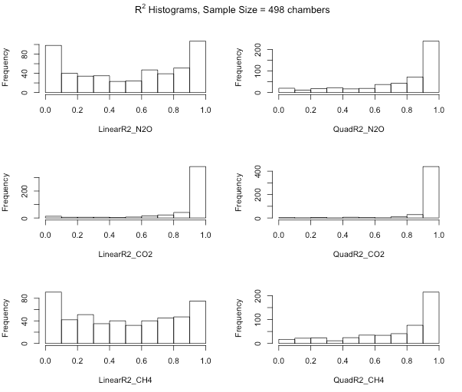
Linear R² values for methane are not much worse than N₂O

Slide 3
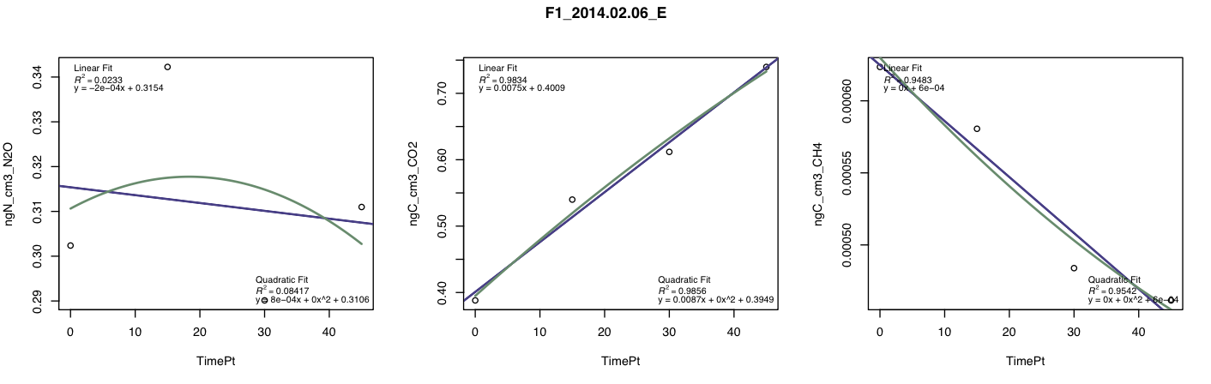
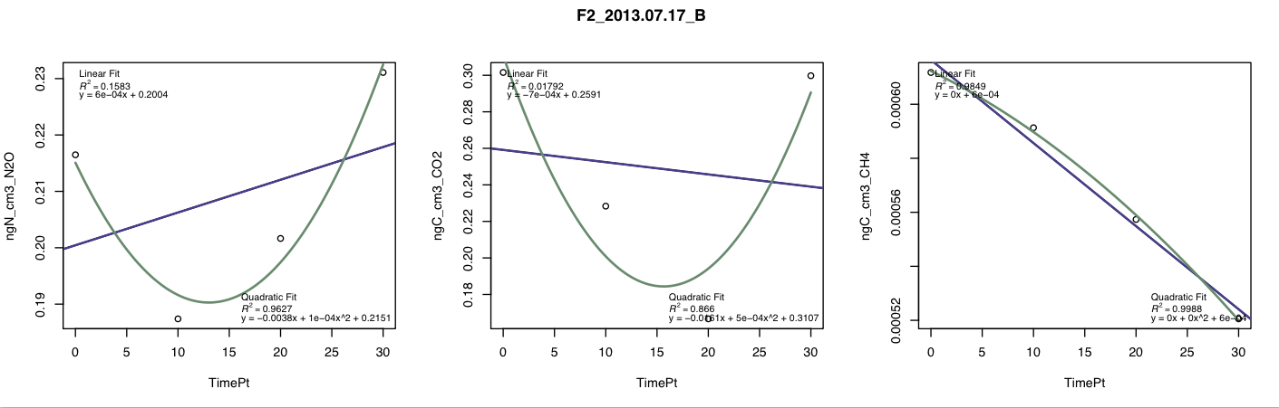
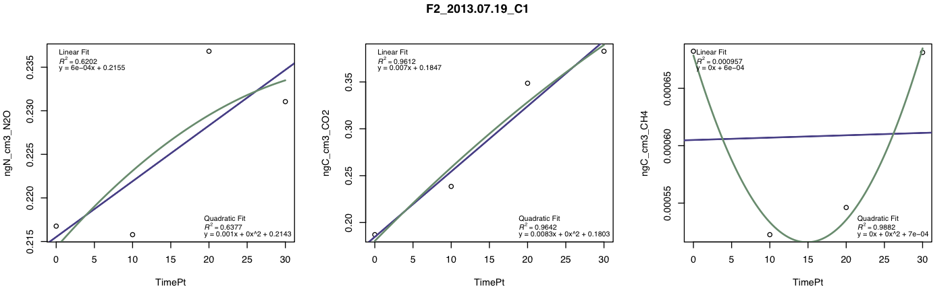
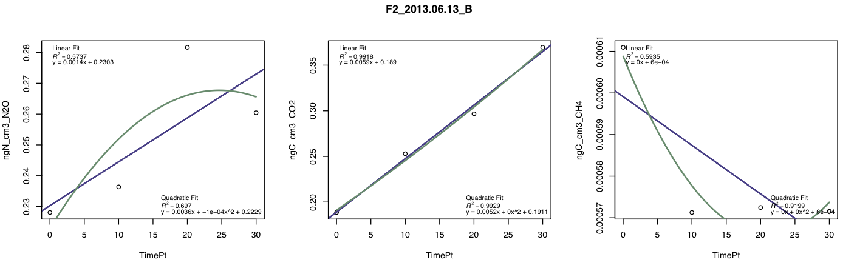
Some of these fits are pretty terrible – why would N2O and CH4 sometimes be terrible on their own without the other also being terrible? Eric says that if the CO2 fit is good, the data stays in. Right now I only bump samples if the respiration fit is poor… thoughts?
Notes:
To know about the CH4 in row3 – is .00010 a huge swing, or a swing that’s basically nothing? What are avg meth uptake rates in seasonal trop forests? Because if that swing is peanuts, then you’re possiblymeasuring a “true” zero.
4th row – potential links = water/oxygen mechanism, nh4 mechanism; in situations where available C limits N2O, that should decouple N2O and CH4
Another data option:
Look at the mean +/- std of all the time 0 vials for each site-day, then take the mean time 0 vial value and apply it to all five chambers (or apply it to any chambers that have a time 0 value more than 2 std away from the time 0 mean)
Generally, if the CO2 fit is bad, look by hand at whether human error switched two vials

Slide 4
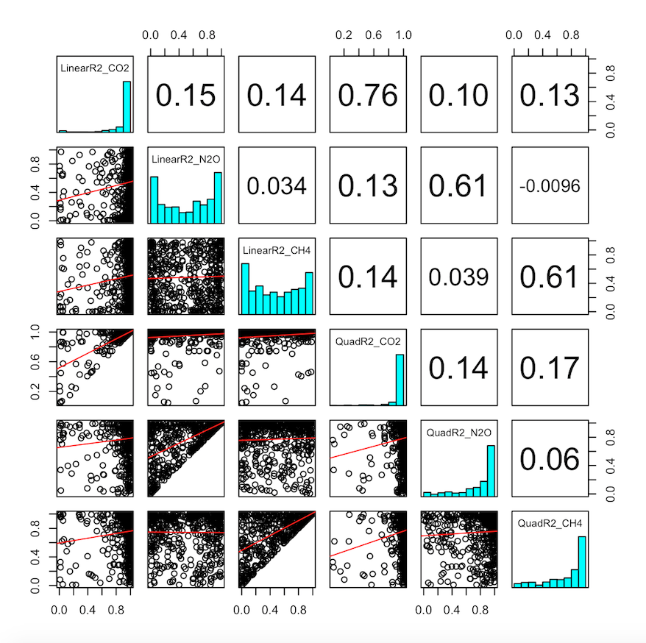

Slide 5
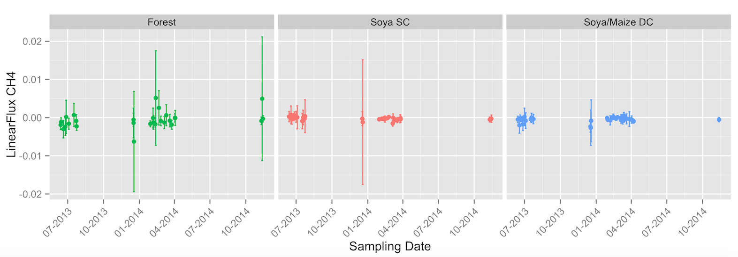
OK, so looks like weak methane uptake in both ag systems, and more clear uptake in forests. But standard deviations are consistently crossing zero. Ugggggggg – how to interpret when we already know that there are clear chamber to chamber differences?
Notes:
Ask Eric and Rod how they go about showing this kind of data – how to distinguish between the replicates of each LU type? Ask Becca Ryals what she’s done.
Maybe instead of showing variance within a site-date, take the mean of the 3 forest sites that you went to over the course of a few days, and get the variance from that – another potential option

Slide 6
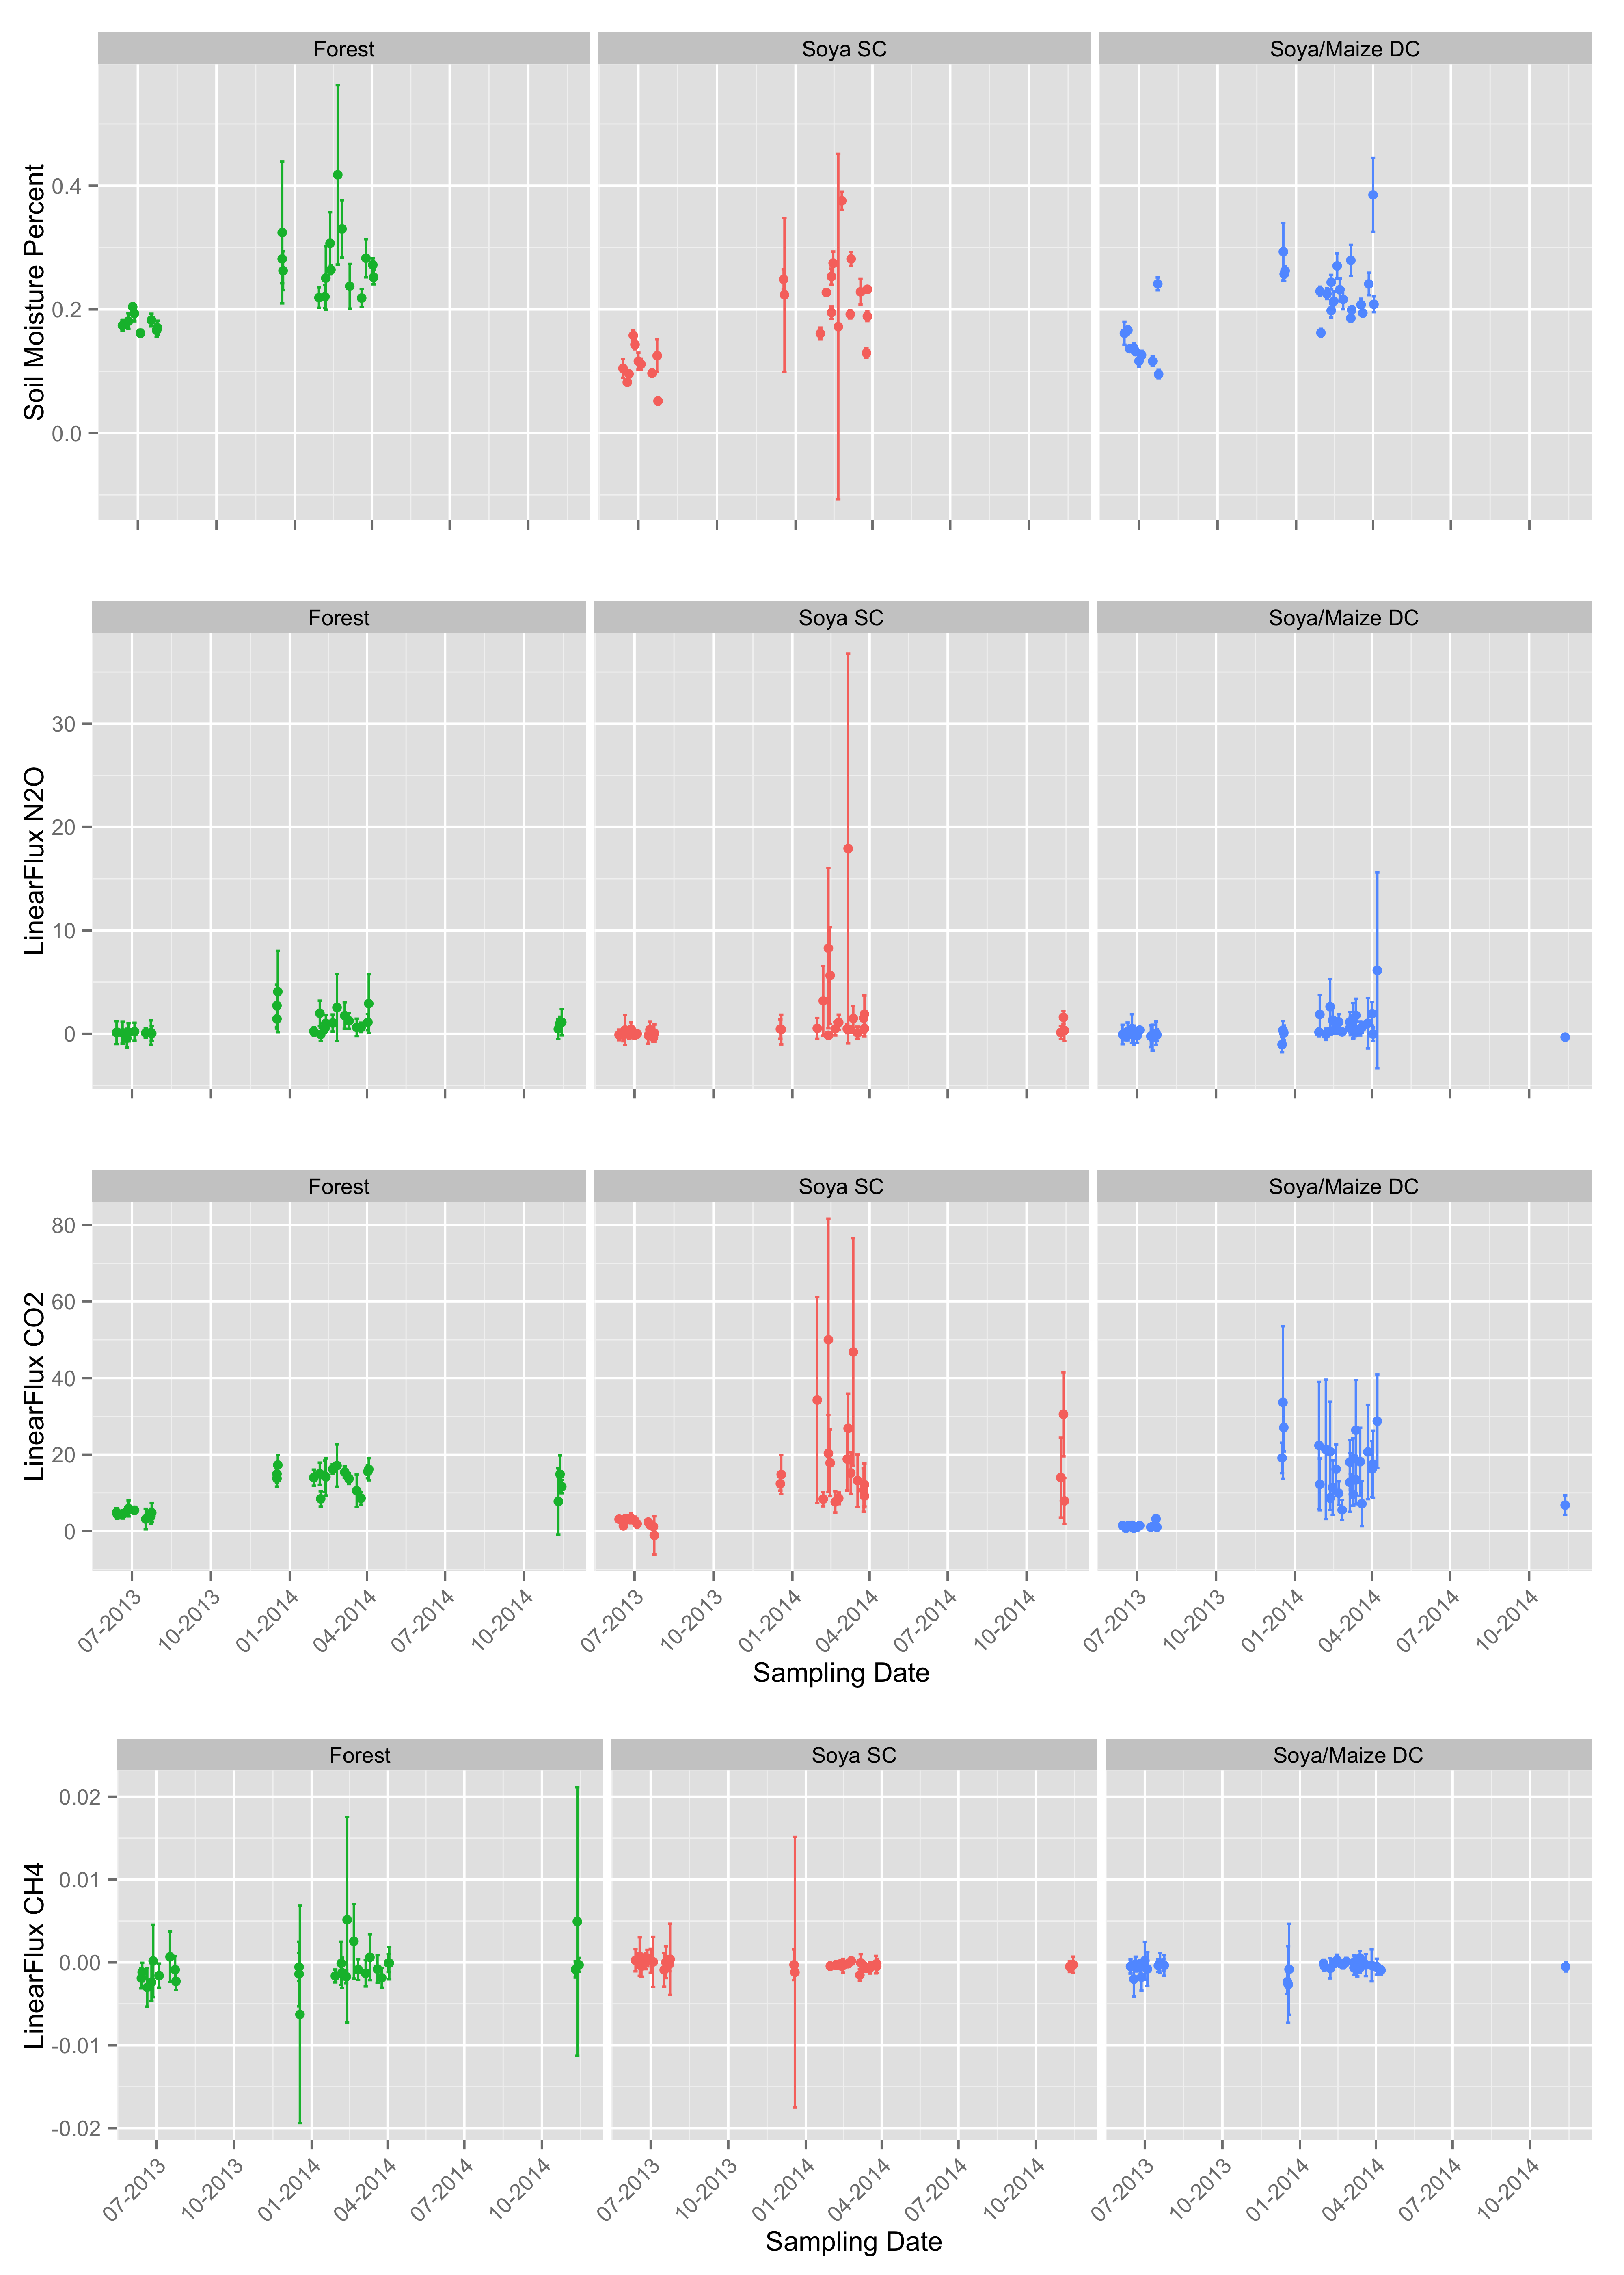
So we can compare to the other trace gases.
Notes:
- Maggi puts on 70kg/year of N fertilizer, so that should be a lot more than the forest has in standing stocks, and there’s way less opportunity for uptake in the fields, since there are fewer plants
- Check out the N min rates (N/ha/year mineralized) as a background supply rate to have in my head

Slide 7
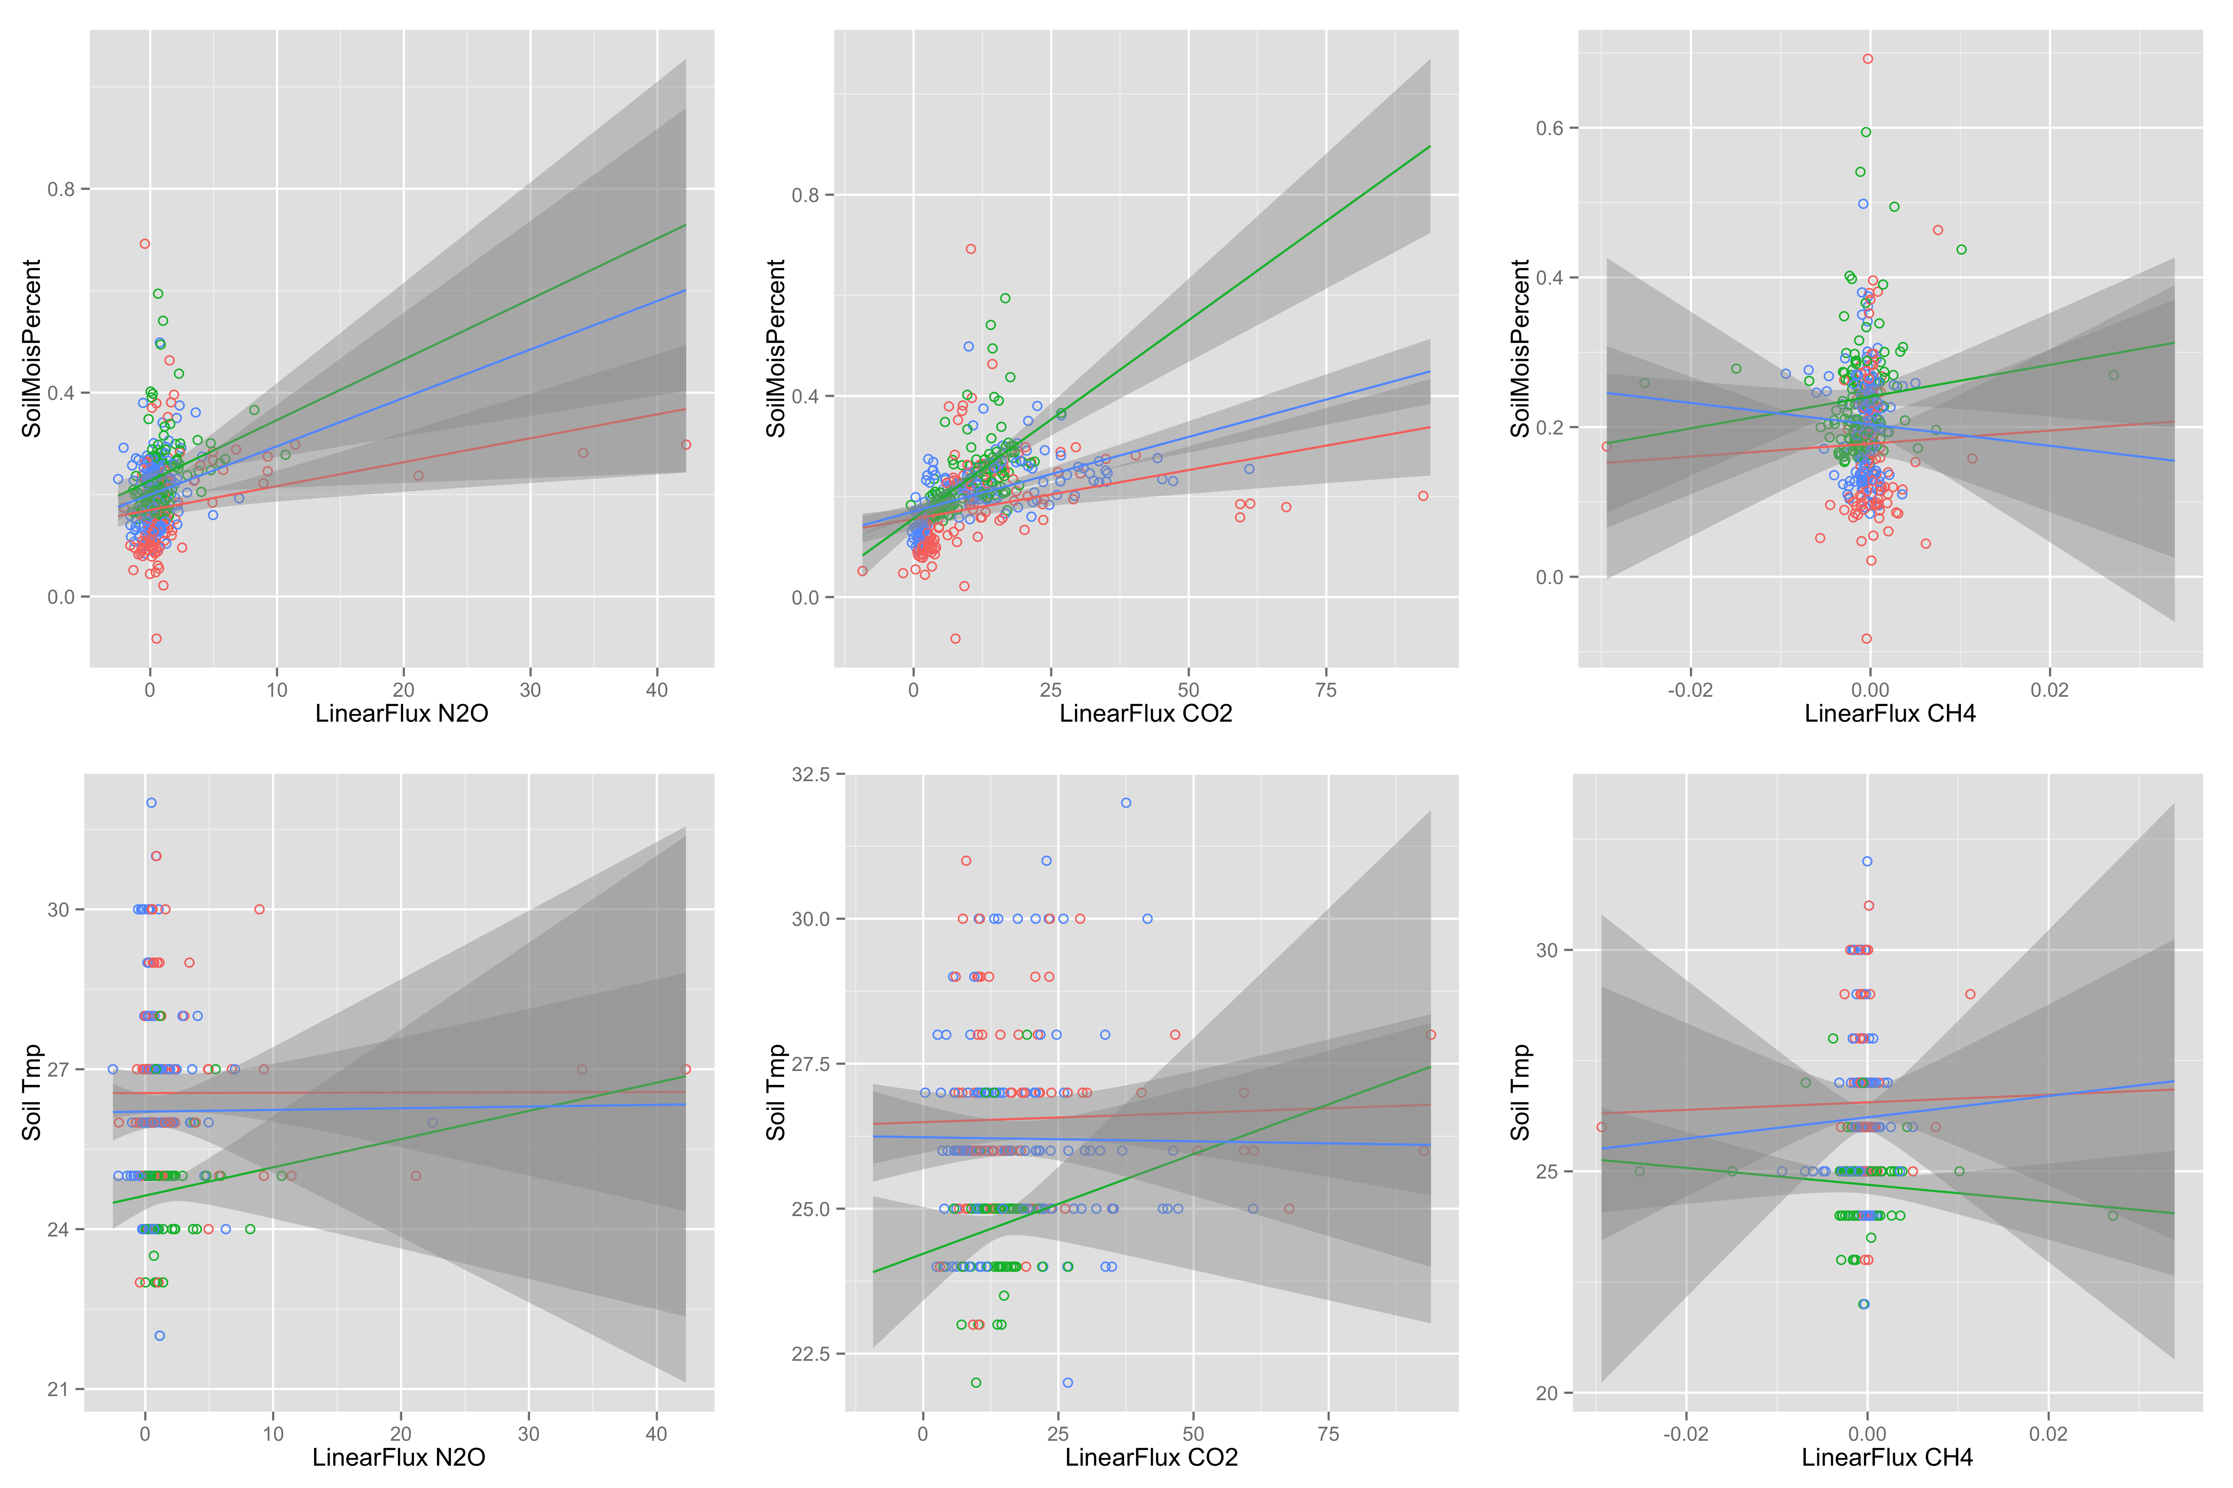
Moisture and soil temp relationships
Notes:
Switch axes!

Slide 8
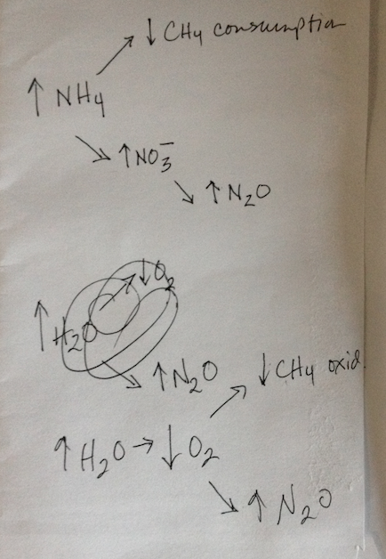
Notes from Sarah mtg are in the comment boxes of various slides in this ppt. This image will help explain the notes in the comment box on slide 3 about CH4-N2O biological links:

